Slide 1
Test Automation Approach for Team Sheshisa
Internal Presentation
Feb 2018

Slide 2
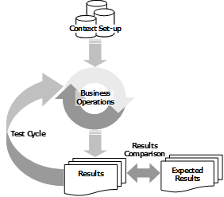
Background Information on Test Automation
In order to be able to determine what can be automated in the testing process, it is important to understand the testing process itself
Testing can be defined as a procedure for critical evaluation; a means of determining the quality or the compliance of something with specified requirements. More specifically, Application Testing consists of the execution of a set of defined (business) operations on an initial dataset to produce a tangible output which is then compared to the expected results. We can thus identify three distinctive steps in the testing procedure:
The context set-up: the creation of the initial dataset (which could also include the set-up of the technical framework needed for the application to operate and the test to be executed)
The execution of a set of business operations,
The comparison of the produced output to the expected results, determined from the requirements and specifications.
If validated, the output of the test can then be reused as initial dataset to continue the tests in a test cycle.

Slide 3
A Holistic Approach to Test Automation
A good test automation strategy, is one that has automated tests on the various layers of each application in a technology landscape, with the most amount of the automated tests in the unit layer, and the least amount of automated tests on the user interface layer.
Test Complexity (Effort)
However, Focus
Will be on
GUI
Automation only
Core multi-step use case/user centric functional tests fall into this category of automation. These tests are typically end-to-end flows and focus on key solution transactions
Coverage
Maintenance
Fragility
Duration
Cost
UI
Feature / function specific component tests fall into this category of automation. These tests are typically web service and/or interface point-to-point flows.
API
Low-level solution code driven tests that confirm the boundaries of methods, classes, and packages fall into this category. These tests are typically code level tests that run on continuous integration environments
Unit

Slide 4
Tool and Framework Analysis
Below are the options that were considered for the tool and framework
# | Options | Pros | Cons
1 | Service Now ATF | Does not require scripting for basic GUI simulation and validation Built in functionality for impersonating users and roll back of data | Requires the latest version of Service Now to be installed Limited to Service Now only Does not integrate with ALM out of the box
2 | HPE / Microfocus Unified Functional Testing (UFT) with EOH Framework | Integrates with ALM Framework is tool agnostic (tool can be changed later) Don’t need to create a framework from scratch | Requires a technical resource to create / maintain the automation scripts
3 | HPE / Microfocus Unified Functional Testing (UFT) with Custom Framework | Integrates with ALM Framework will only work with UFT or Does not requires EOH resources to use the framework | Requires a technical resource to create / maintain the automation scripts Need to create a framework from scratch
4 | SoapUI | Industry standard for API testing Integrates with ALM | Free version does not support data driven testing and requires a coded framework to simulate this
Notes:
Sasol is currently still investigating tooling for DevOps implementations
The selected tools and frameworks may need to be revised after other DevOps automation tools have been selected
It has been decided that UFT with a custom hybrid framework will be used for GUI automation (option 3 above)
Currently still investing the REST API testing

Slide 5
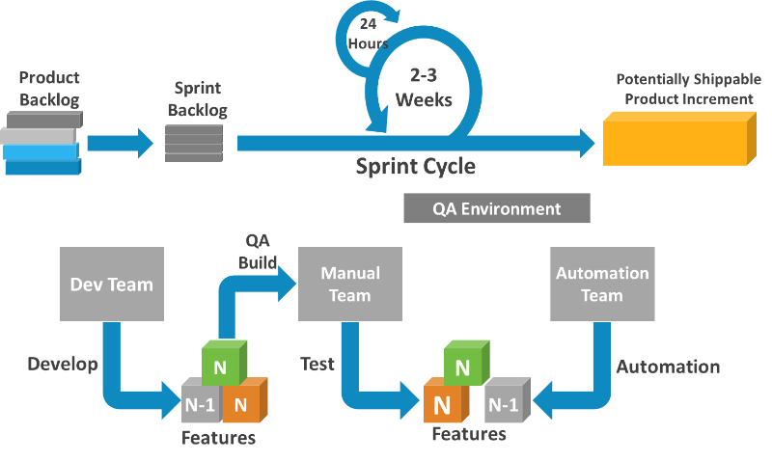
High Level Approach
Focus will be GUI based test automation
However still investigating the possibility of automating Service Now testing via the REST API (Ideally we should have more API based automated tests than GUI based automated tests)
The focus will be on automating high quality regression test cases – to give the highest benefit
We will also use our specified selection criteria to determine which tests will be automated
Test Execution will be driven from HPE ALM
The focus will be on automating test cases from sprint N – 1 (for future phases of the project)
However, since the project started without test automation, the will focus will be to catch up to sprint N -1 features

Slide 6
Selection Criteria for Automated Testing
The following criteria will determine which regression test cases are selected to be automated
Functional Test Scenarios
End to end business functionality of the most commonly used functions.
Common transactions
Business Criticality
Business critical areas of the applications
Critical validations
Repetitive
Tests that are repeated across test scenarios
Tedious
Tedious manual tests especially ones requiring excessive data entry that usually result to human errors if done manually.
Large volume transactional data entry
Frequency of Use
Tests that are executed frequently requiring data comparison or validation

Slide 7


Hybrid Automation Framework Design
Function Libraries / Modules
Object Repositories
Script Driver
Reporting

Slide 8
Test Environments & Test Data Management
Test Environments
The automated tests will be scripted and executed on the QA environment
QA Environment:
https://solqa.service-now.com
Test Data Management
Test data will be created by the automated tests
Existing user accounts / roles on the system will be used
i.e. Requestor, Manager, BRM User, Fulfiller

Slide 9
Reporting & Definition of Done
Reporting
HPE ALM will be used for all reporting
Daily Execution Reporting
Project Reports will be drawn from HPE ALM
Definition of Done
Script
Script has been written according to scripting standards
Script executed and successfully passed
Sprint
Automated Regression tests has been executed

Slide 10
Defect Management
Upon the failure of the automated test execution, the tests will be investigated to determine the reason for the failure
Team to help determine if it’s a valid defect or not
If it is a valid defect, then the defect to be logged in HPE ALM
If it is a script issue, then the script will need to be fixed

